Slide 1
Twitter Location K Center Clustering
Roberto Xu

Slide 2
Problem
Twitter, and social media in general, have seen exponential increases in usage over the years.
Users post various updates on life events, personal life, and other random details.
All this user generated data can be mined and used for things like product reviews, popularity of a certain show or movie, and even presidential election predictions.
Most common way of getting location : IP addresses
However, VPN, proxies, and dynamic IP’s mask the true location of a user.

Slide 3


Problem cont.
Twitter has 2 ways : GeoTagging, and a “Location” text field in their profile.
Less than 1% are GeoTagged, and about 34% of users provide incomplete or inaccurate data in their profile.
To solve this: Identify the location of a user based on the content of their Tweets

Slide 4
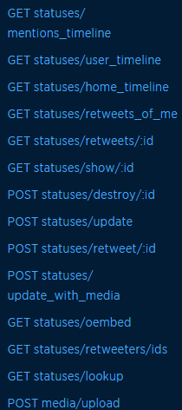
Twitter API
REST API using OAuth
API Rate Call Limits – Every 15 minutes
User, followers, following – 15/window
Tweets, friends, users – 180/window
Maximum of 200 rows per call.
Up to only the most recent 3200 tweets.

Slide 5
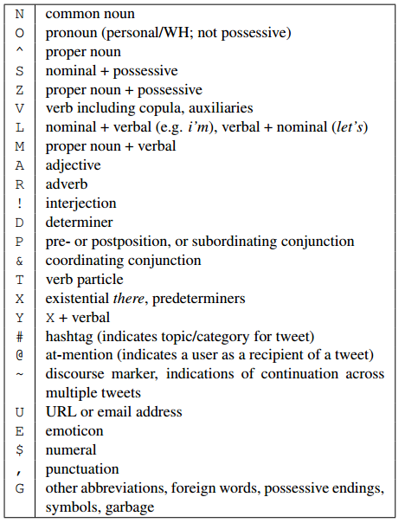
Natural Language Processing
Ark-NLP – Carnegie Mellon
Just for Twitter, Tokenizer and Part-of-speech tagger.
Give it the tweets of a user, and it will return the tag which classifies the type of word.
Strip everything else besides proper nouns to be used in the gazetteer

Slide 6
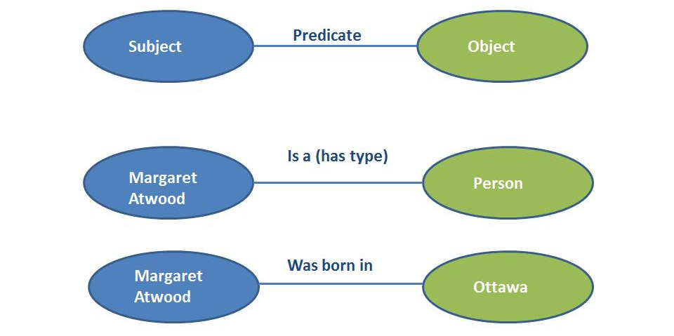
Gazetteer
Geographical dictionary – Name and Coordinates
DBpedia – Crowd Sourced database that extracts information from Wikipedia
SPARQL – SPARQL Protocol And RDF Query language.
RDF – uses triples : subject-predicate-object

Slide 7
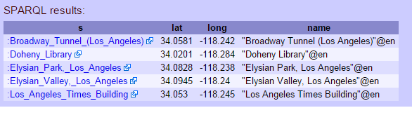
SPARQL
PREFIX geo: <http://www.w3.org/2003/01/geo/wgs84_pos/>
PREFIX dbo: <http://dbpedia.org/ontology/>
SELECT * WHERE {
?s a dbo:Place .
?s geo:lat ?lat .
?s geo:long ?long .
?s rdfs:label ?name
FILTER ( ?long > -118.3 && ?long < -118 && ?lat > 34 && ?lat < 34.1)
}
LIMIT 5
Dbo:Place = Dbpedia.org/ontology#Place

Slide 8
Coordinate Distance
Spherical Law of Cosines
Δlat = lat2− lat1
Δlong = long2− long1
a = sin²(Δlat/2) + cos(lat1) * cos(lat2) * sin²(Δlong/2)
c = 2 * atan2(√a, √(1−a))
d = R * c
R = Radius of Earth (in whatever measurement)

Slide 9
K-Center Clustering
K amount of clusters
Radius = distance from the center of each cluster
Randomly choose a point to be the first center
For I = 2 up to K,
Next center is the point with maximum distance from all center
Then, assign all unclustered points within the radius of each center to the clusters
Predict the center of the cluster with most points

Slide 10
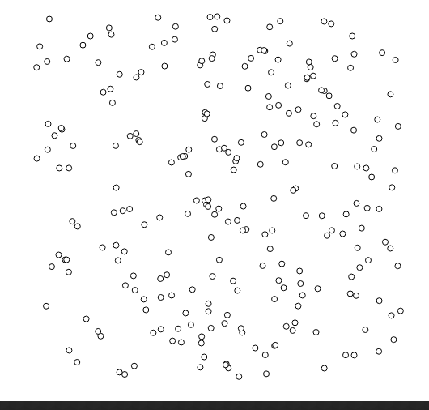
Step 0

Slide 11
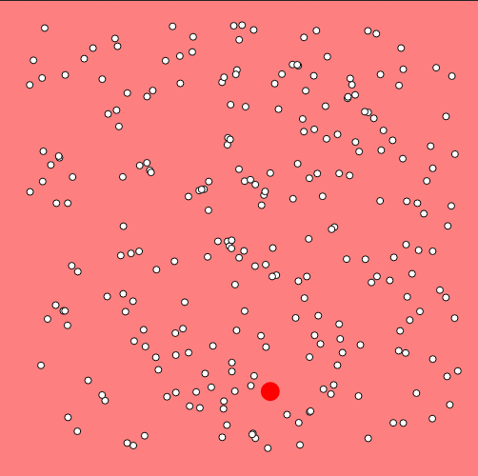
Step 1

Slide 12
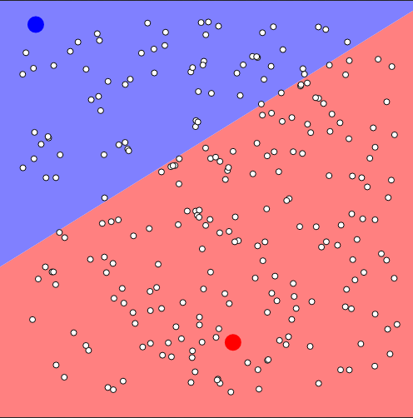
Step 2

Slide 13
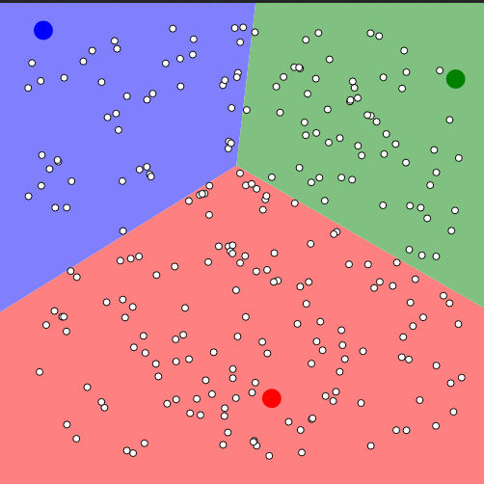
Step 3

Slide 14
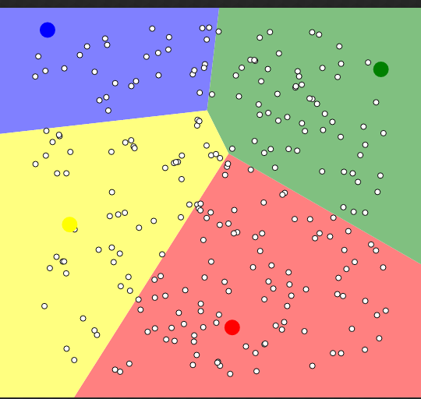
Step 4

Slide 15
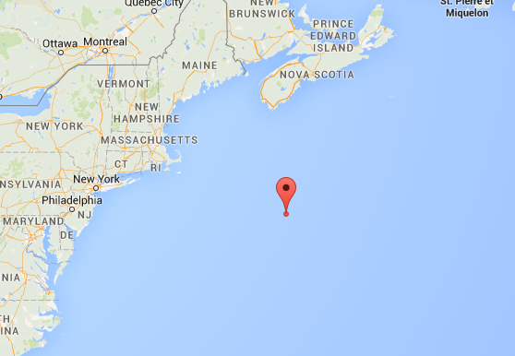
Accuracy
Can only compare with user description and profile
Can range from 100 miles to 10000 miles difference.
Each cluster starts off at a random position, so every cluster is different.
Location from gazetteer isn’t perfect
Acronyms

Slide 16
Future
Improvements in querying the gazetteer
Comparison with other algorithms
Collect more data

Slide 17
Demo

